Slide 1
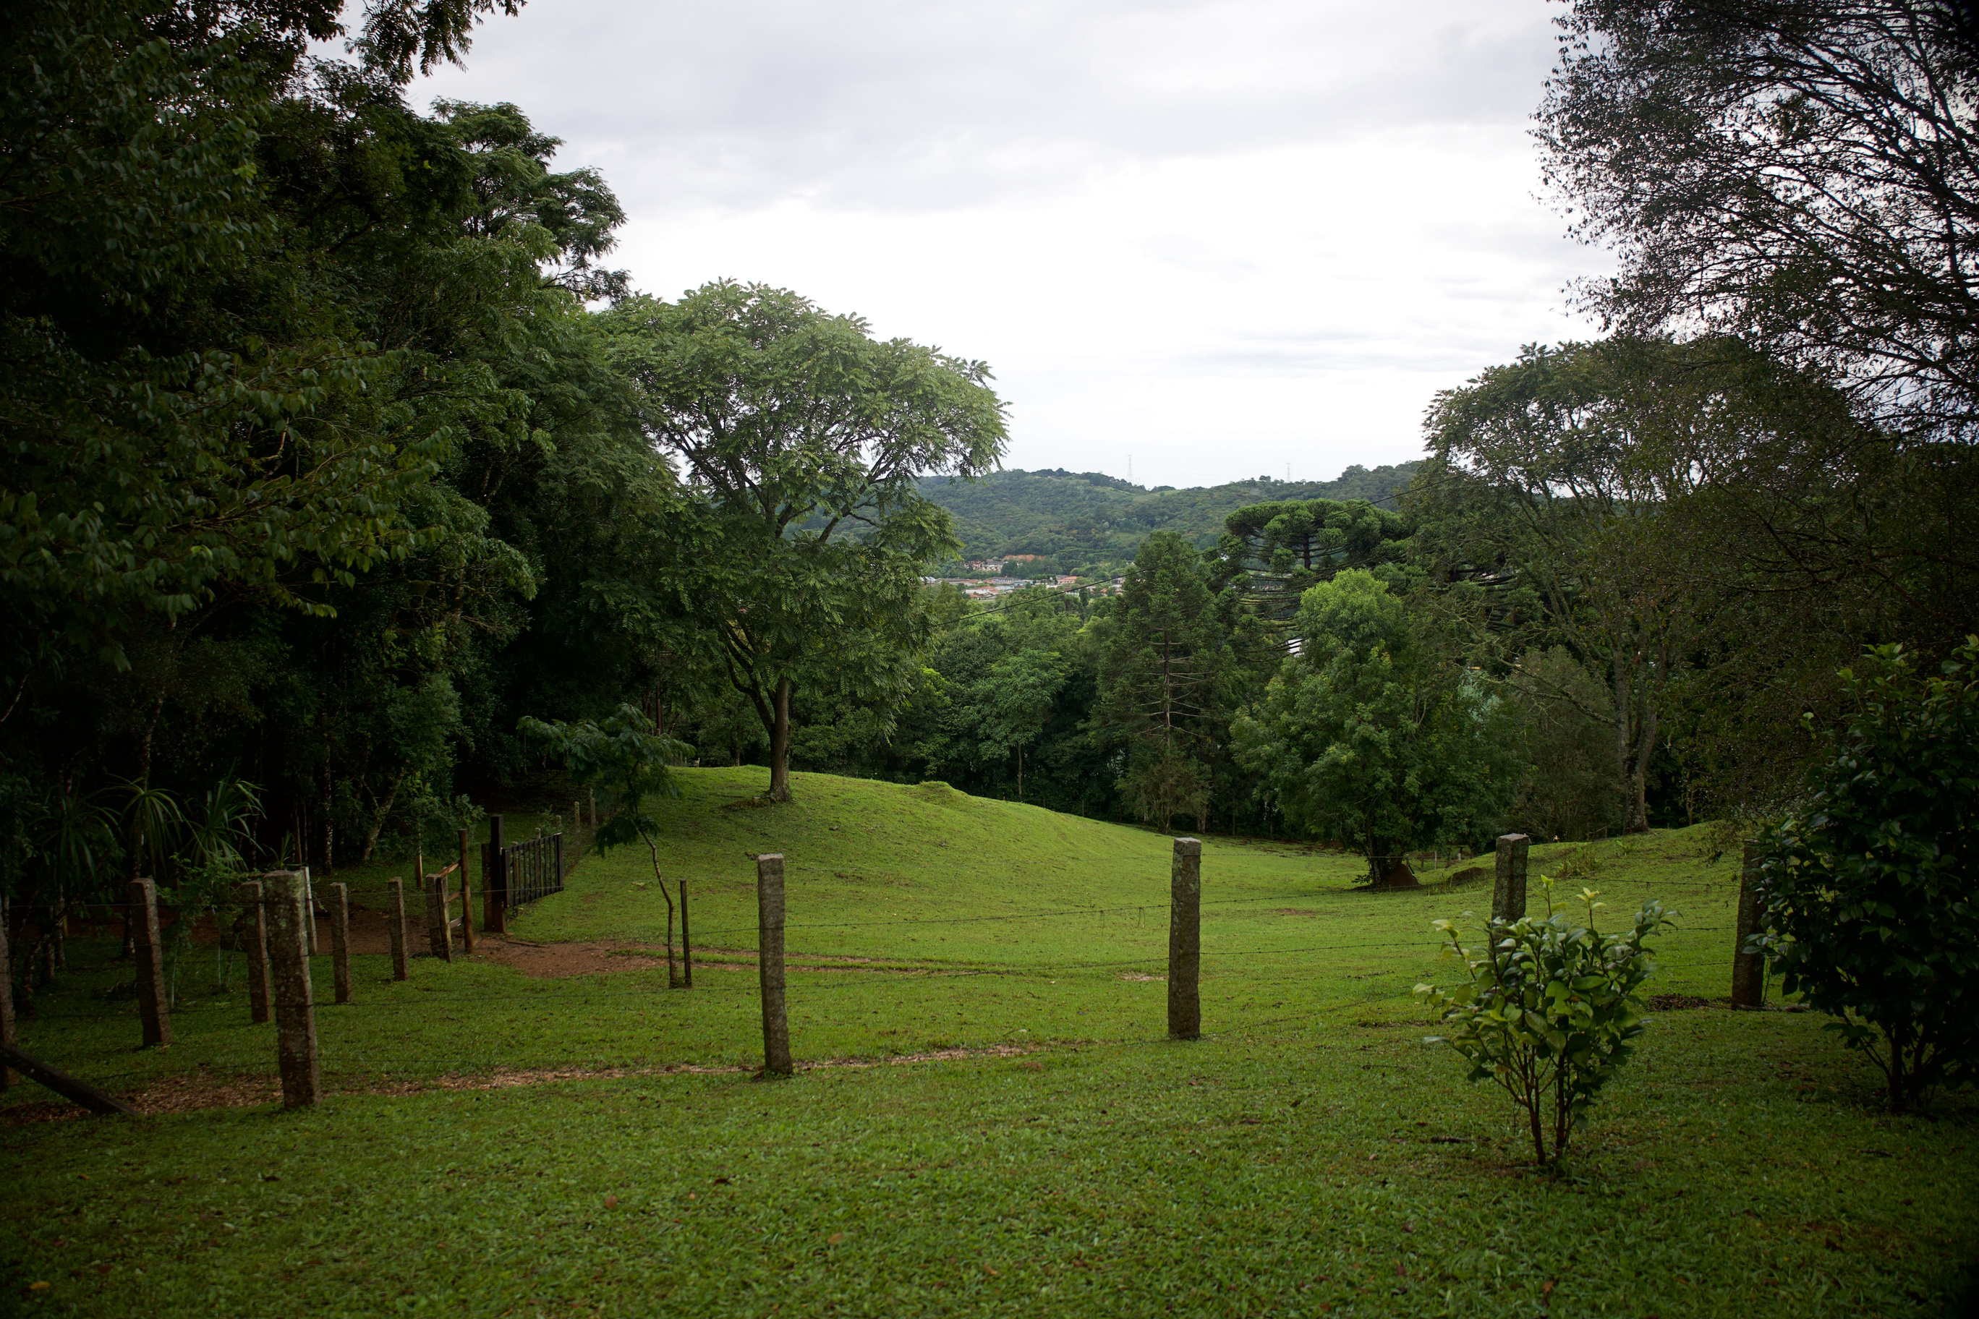

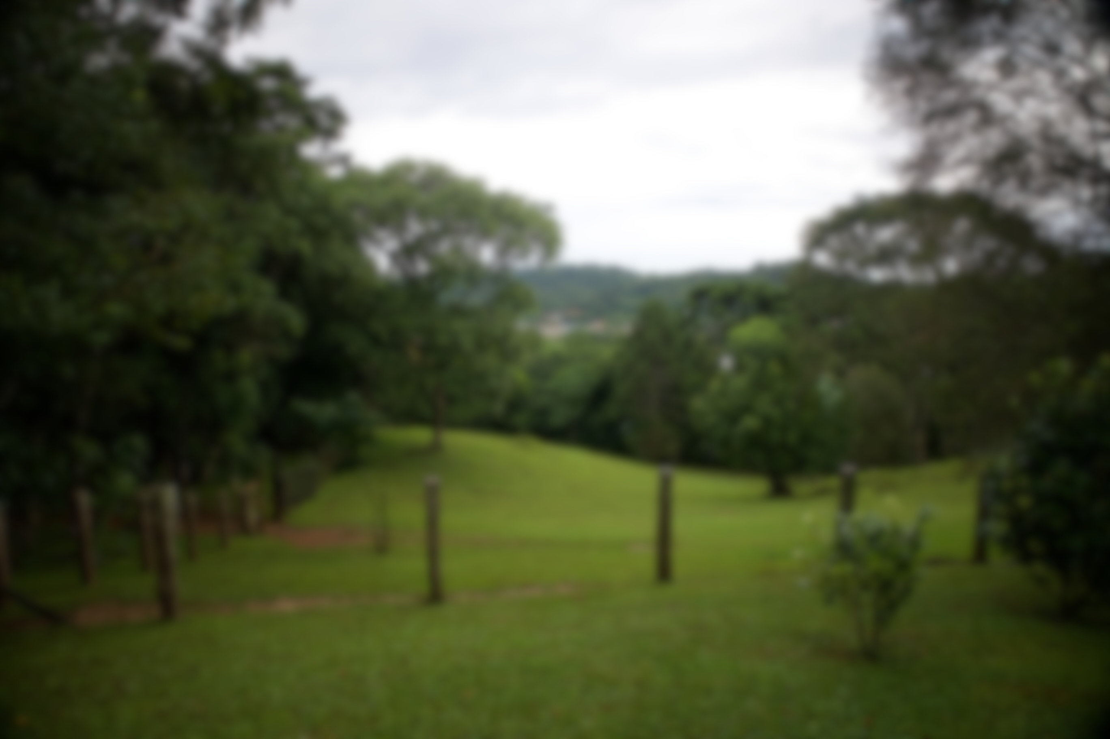
WORLD MISSIONS
The Global Ministry of the AFLC
aflcworldmissions.org

Slide 2



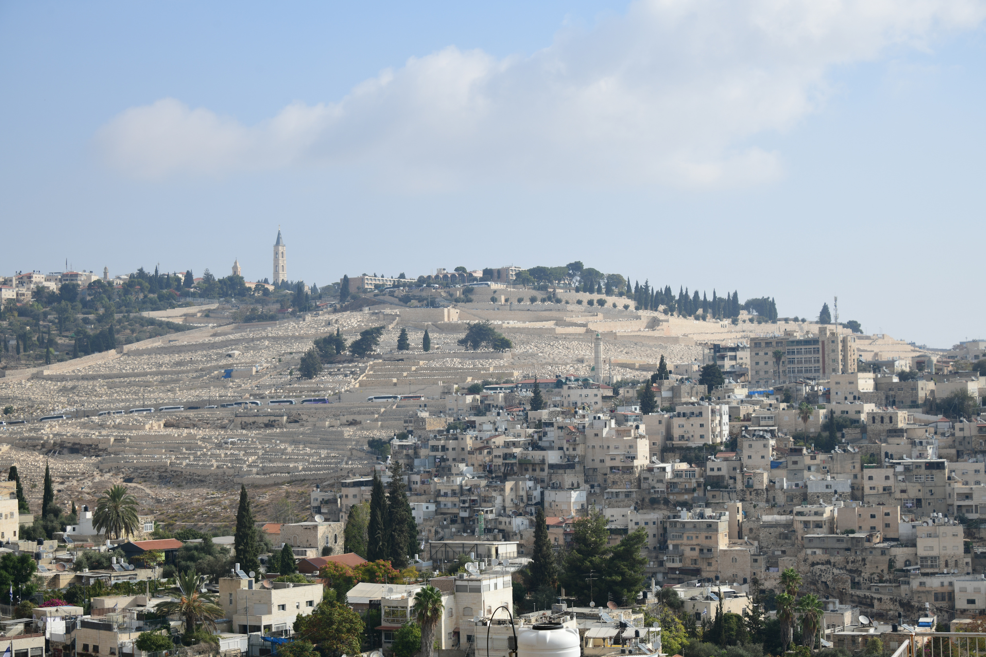
Our Mission
& Goals
Mission
We endeavor to go into all the world , proclaim the gospel message, plant gatherings of Christians, and equip these growing churches in the study of the Word of God.
Goals
  Planting free and living Lutheran congregations
  Reaching unreached people groups
  Establishing Biblical training
  Developing independent congregations
  Serving those in need with compassion
  Preparing future missionaries for service on the field

Slide 3




AFLC Missionaries
Brazil
Uganda
  Jonathan & Tamba Abel
  John & Hannah Lee
  Paul & Becky Abel
  Jonni Sliver
  Nate & Rhoda Jore
  Michael Rokenbrodt
  Brent & Emily Raan
Paraguay
Mexico
  Matthew & Ednay Abel
  Todd & Barb Schierkolk

Slide 4
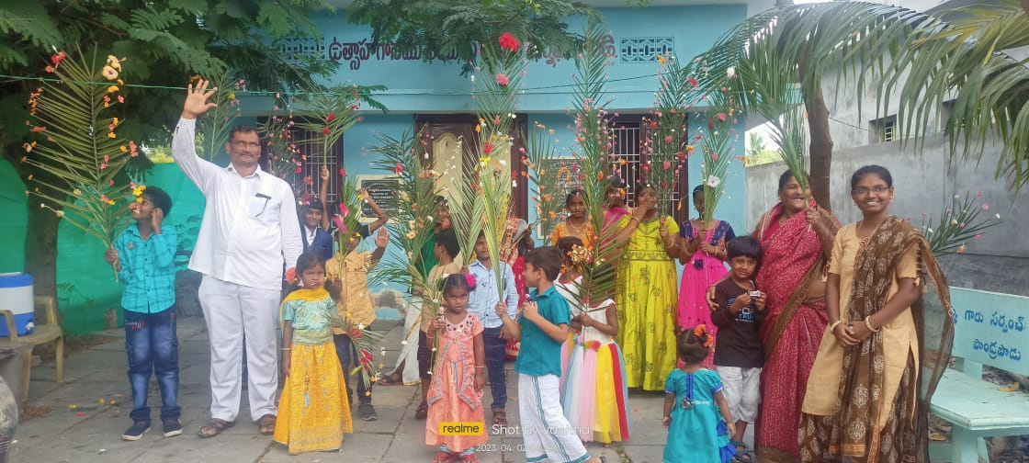
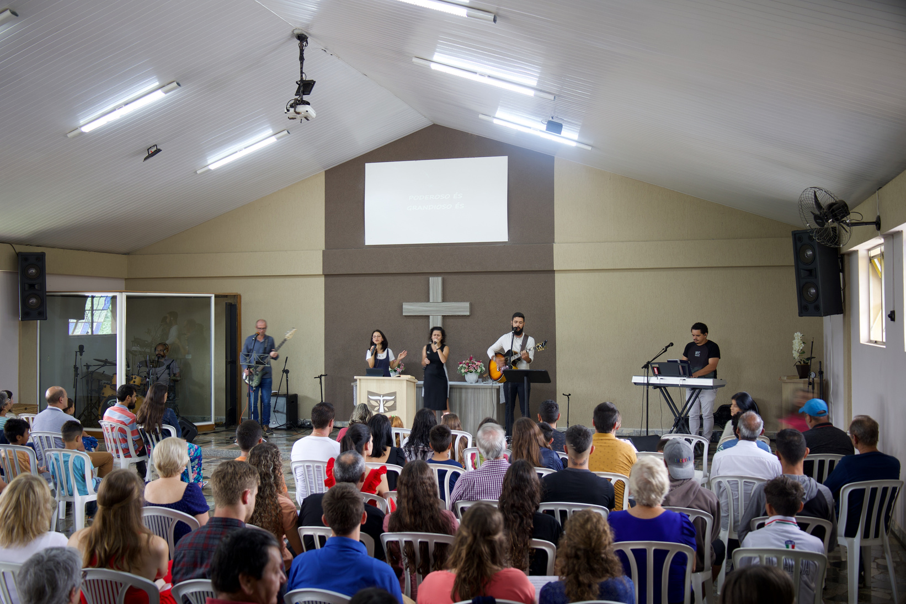
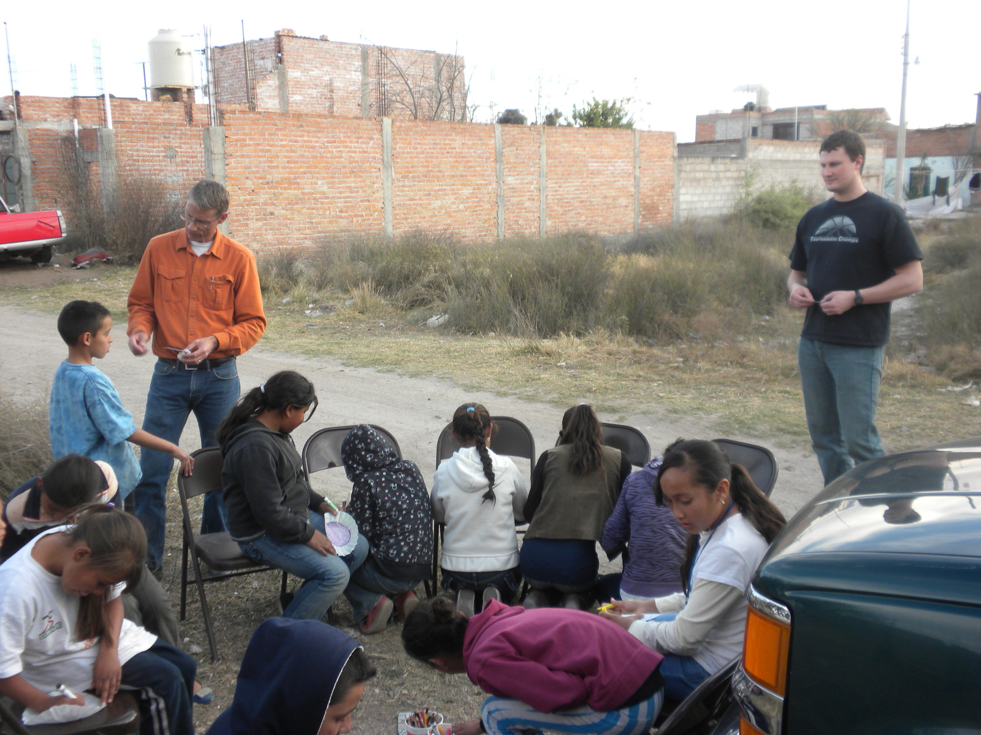
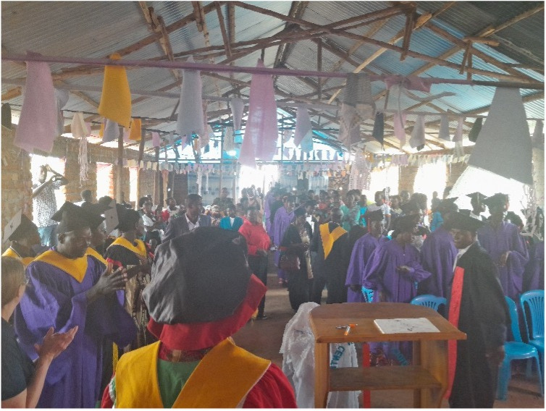
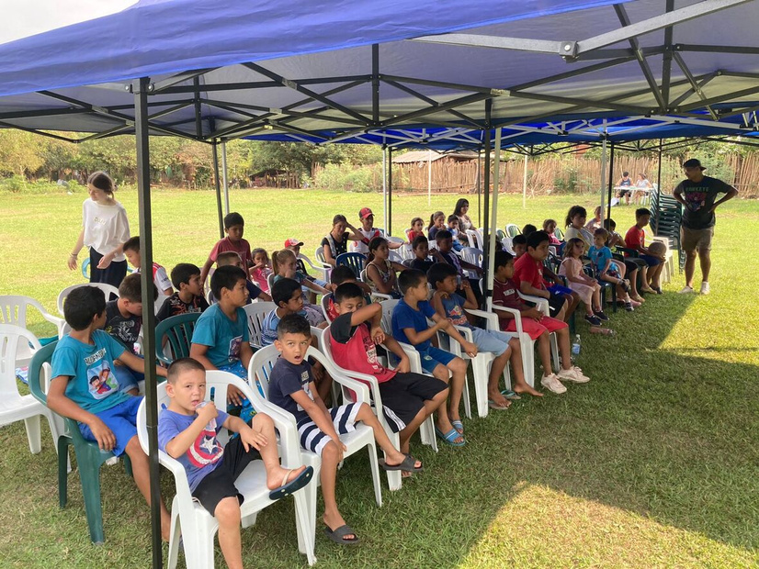
Special Projects
Uganda
Paraguay
Ambassador Institute Workshops
Pantry for the Poor, Church library, Pavilion
India
Brazil
Mexico
Bibles, Pastor Housing, Theological training
DRELL, SETELL, ARCA van, Follow them Home, Building projects
Building projects, Christmas gifts, Bibles

Slide 5
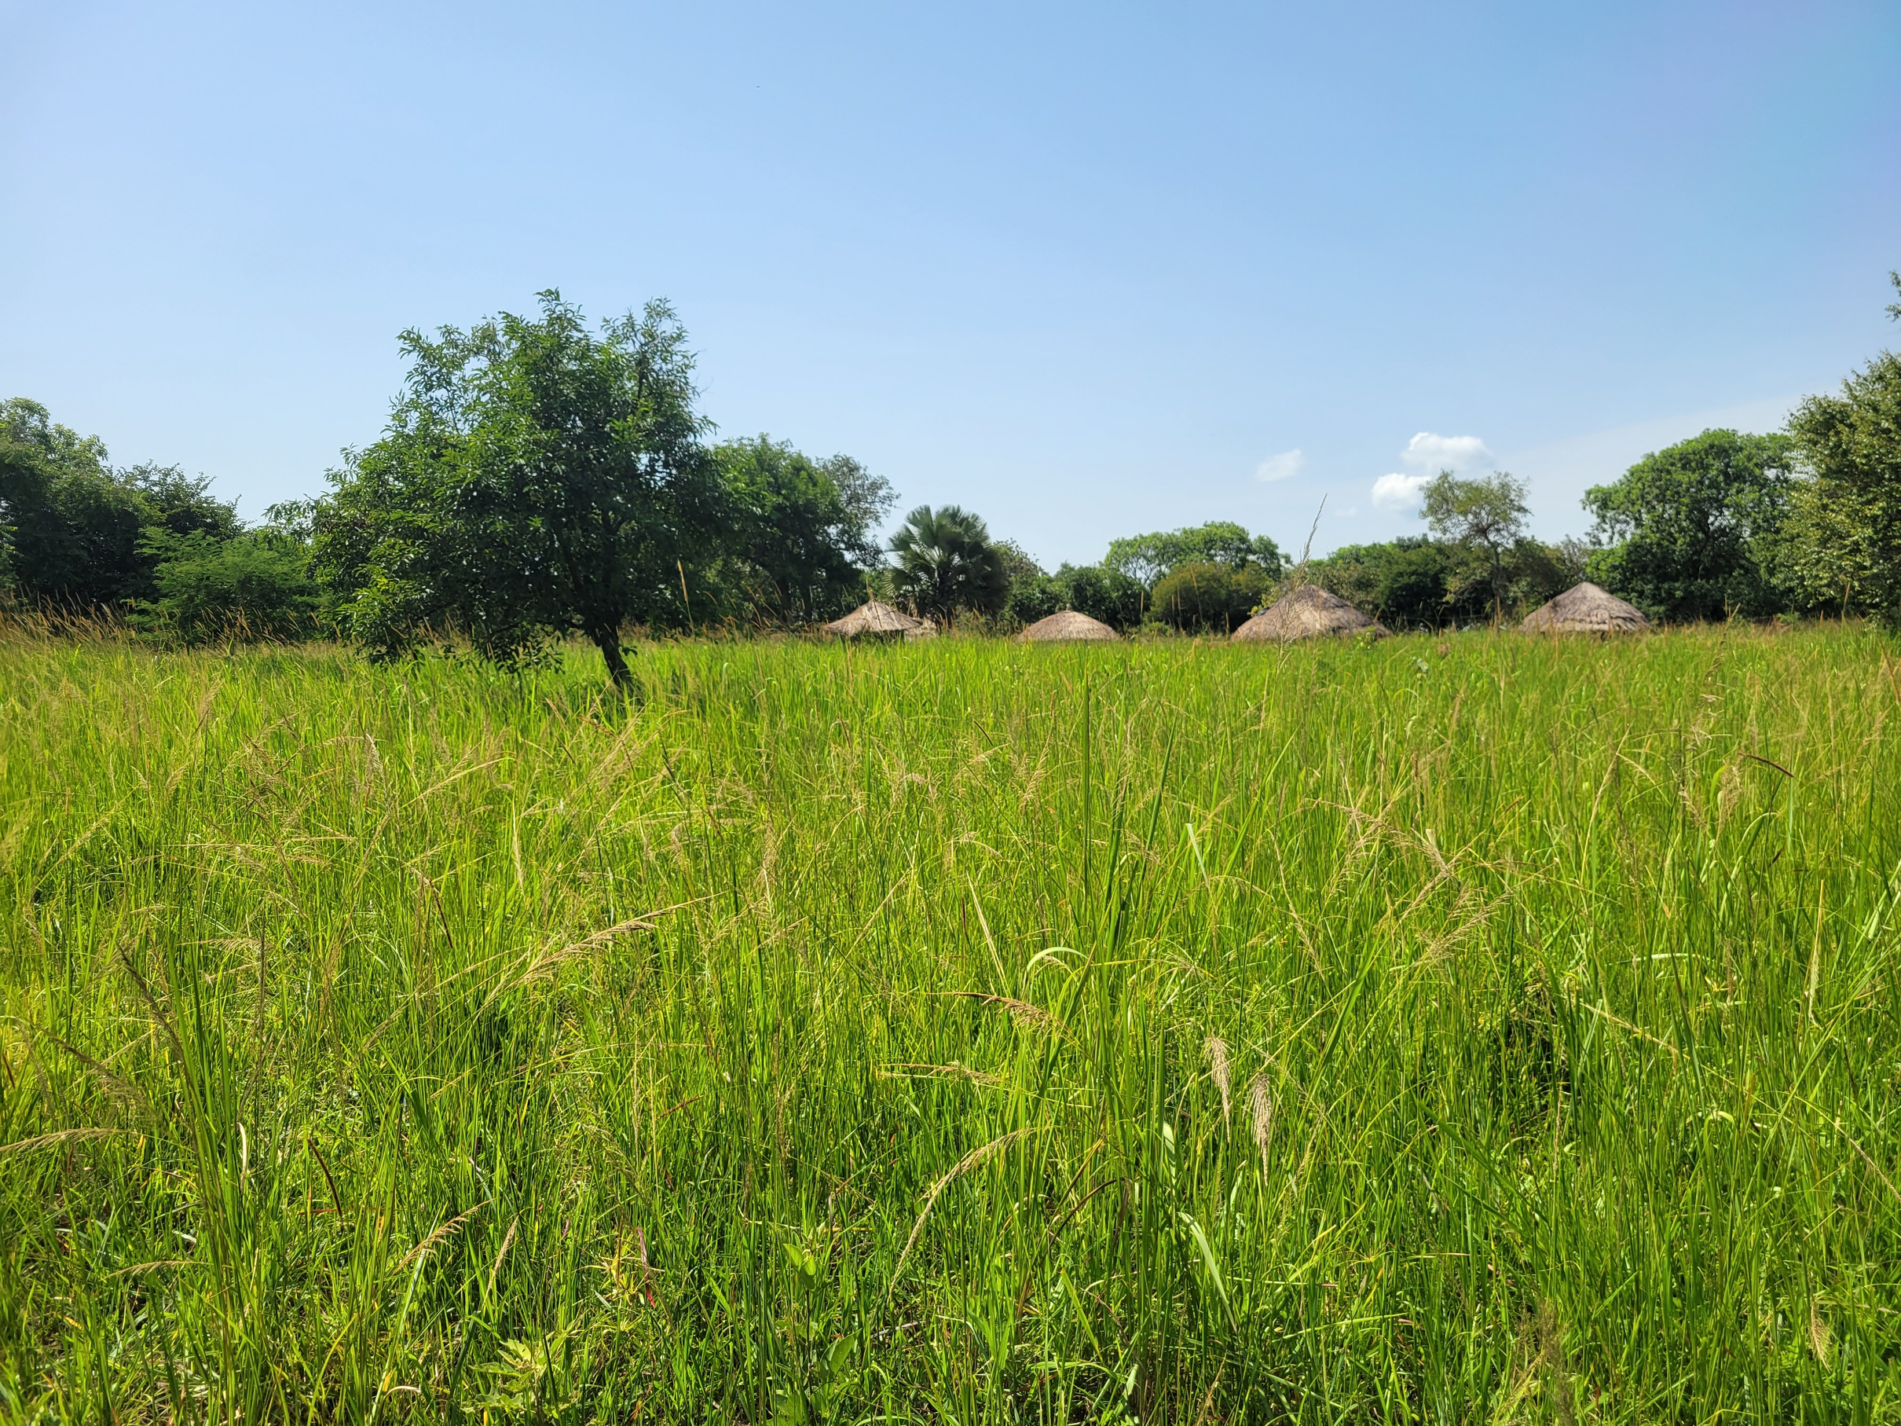
Partner with us
1
2
3
Continual Prayer for our Missionaries and Ministries
Read our Newsletters and Follow us on Social Media
Monthly Financial Support

Slide 6
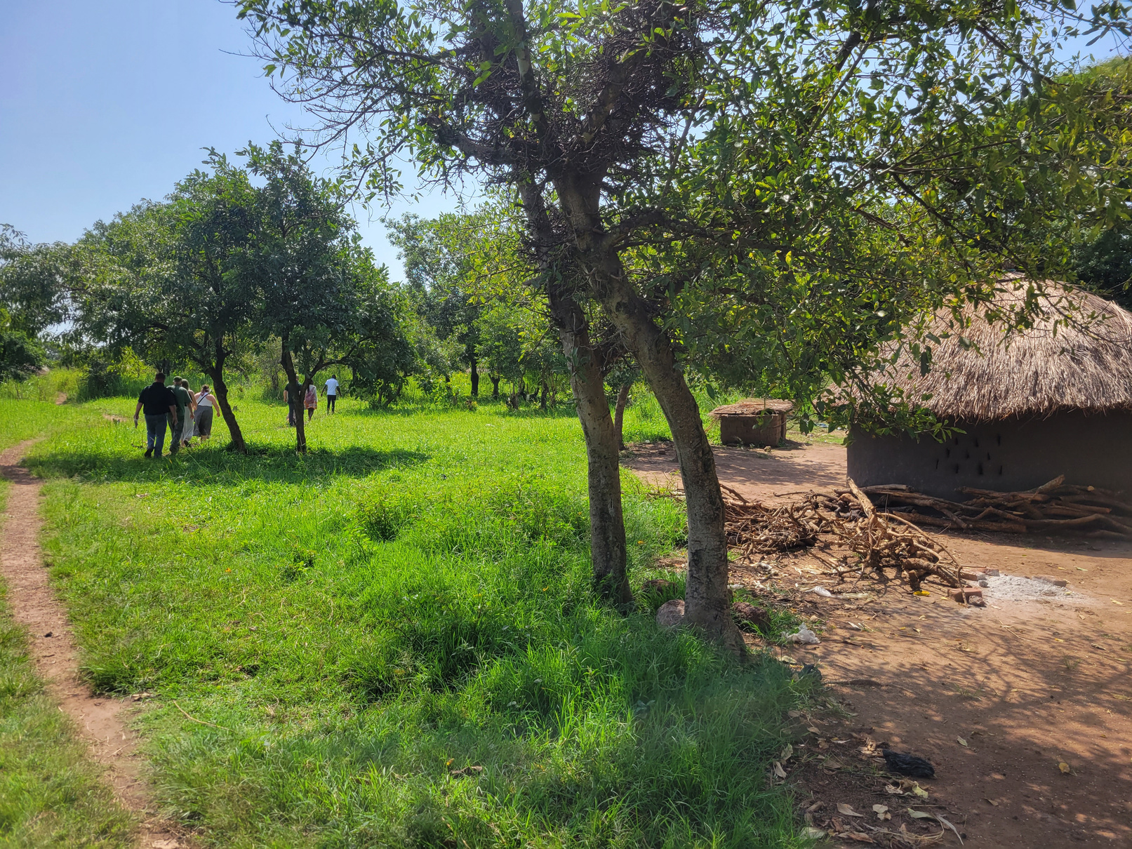
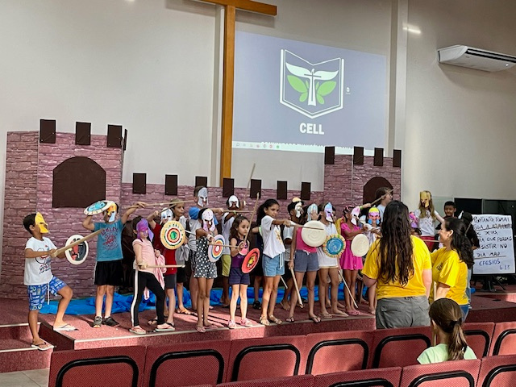
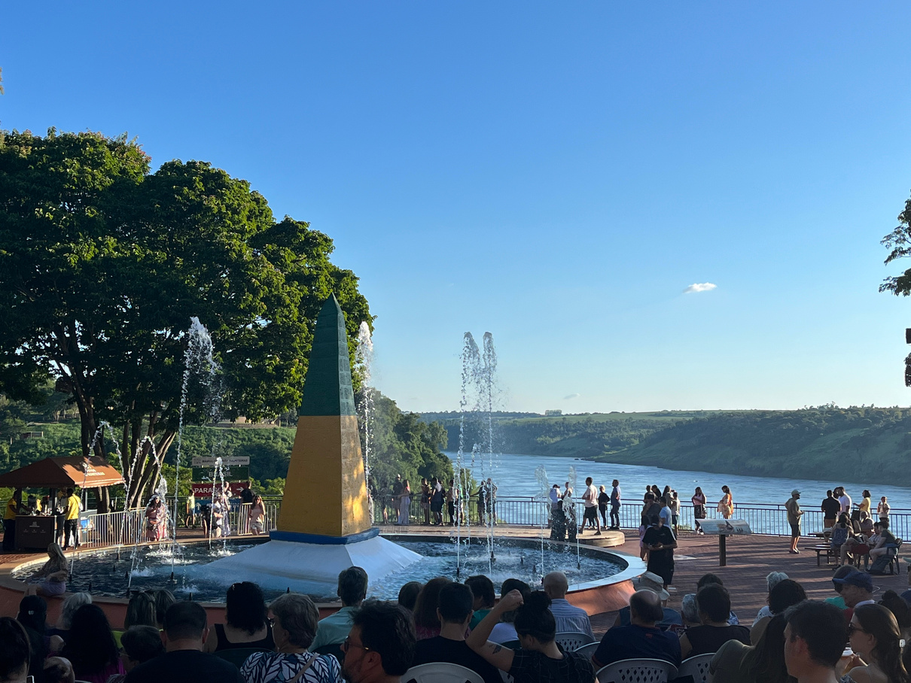
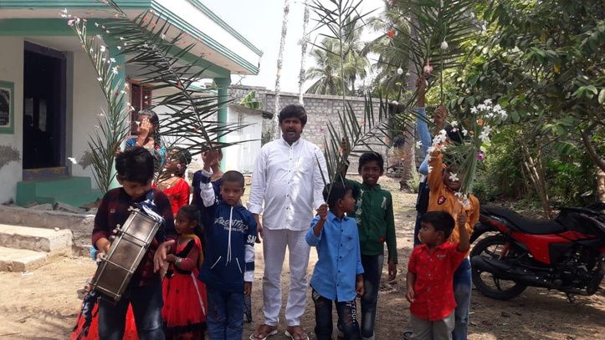
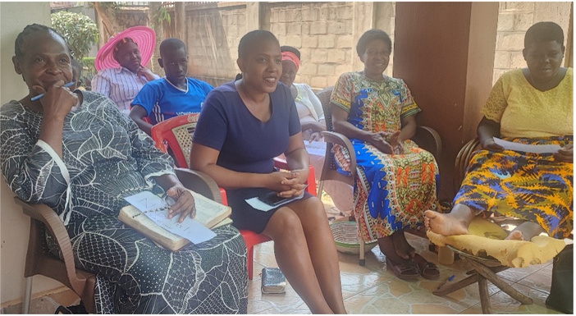
Thank you
For your continued support

